Slide 1
Initiate Renewal

Slide 2
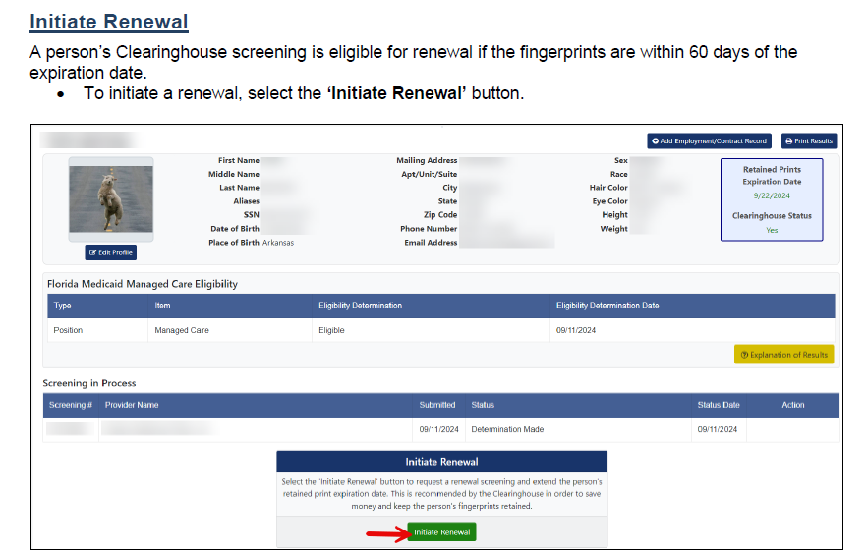

Slide 7
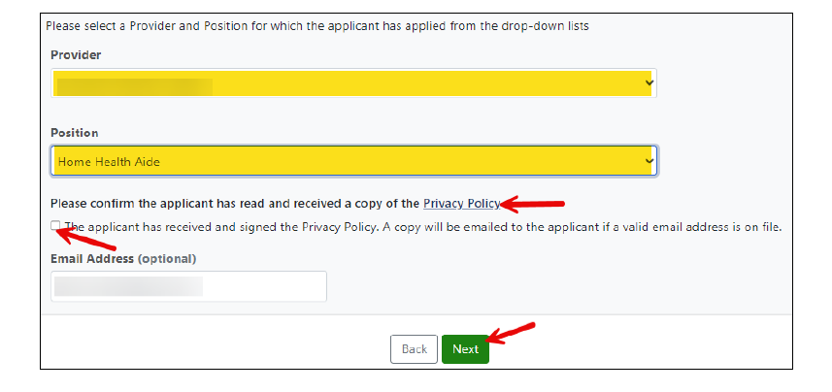

Slide 12
